Slide 1
Capacity Building Training on Machine Learning
Dr. Muhammad Imran
Associate Professor

Slide 2
Contents – Univariate Time series forecasting
How the ARIMA/SARIMA model works?
Components of the ARIMA/SARIMA model
check for stationarity
Implementing Augmented Dickey-Fuller test
Training/testing the ARIMA/SARIMA model

Slide 3

Time Series Forecasting
A time series is a sequence where a metric is recorded over regular time intervals.
Examples include:
annual budget – recorded on yearly basis,
expenses – recorded on monthly basis
sales – recorded on weekly basis,
weather – recorded on daily basis
stocks prices – recorded on hourly basis,
inbound calls in a call canter – recorded on minutes basis
web traffic – recorded on minutes and even seconds wise basis

Slide 4
Time Series Forecasting
Forecasting is to predict the future values the series is going to take.
Forecasting a time series (like demand and sales) is often of tremendous commercial value.
In most manufacturing companies, it drives the fundamental business planning, procurement and production activities.
Any errors in the forecasts will ripple down throughout the supply chain or any business context for that matter.
So it’s important to get the forecasts accurate in order to save on costs and is critical to success.
But why forecast?

Slide 5
Time Series Forecasting
Forecasting a time series can be broadly divided into two types.
If you use only the previous values of the time series to predict its future values, it is called Univariate Time Series Forecasting.
And if you use predictors other than the series (a.k.a exogenous variables) to forecast it is called Multi Variate Time Series Forecasting.
Types of Time Series Forecasting

Slide 6
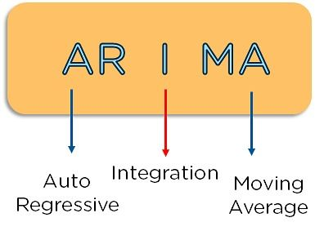
Introduction to ARIMA model
ARIMA, short for ‘AutoRegressive Integrated Moving Average’, is a forecasting algorithm based on the idea that the information in the past values of the time series can alone be used to predict the future values.

Slide 7
How does ARIMA/SARIMA model work?
Any ‘non-seasonal’ time series that exhibits patterns and is not a random white noise can be modeled with ARIMA models.
An ARIMA model is characterized by 3 terms: p, d, q; where,
p is the order of the AR term
q is the order of the MA term
d is the number of differencing required to make the time series stationary
If a time series, has seasonal patterns, then you need to add seasonal terms and it becomes SARIMA, short for ‘Seasonal ARIMA’.

Slide 8
How does ARIMA/SARIMA model work?
The first step to build an ARIMA model is to make the time series stationary.
The most common approach to make a series stationary is to difference it.
That is, subtract the previous value from the current value.
Sometimes, depending on the complexity of the series, more than one differencing may be needed.
The value of d, therefore, is the minimum number of differencing needed to make the series stationary. And if the time series is already stationary, then d = 0.

Slide 9
How does ARIMA/SARIMA model work?
‘p’ is the order of the ‘Auto Regressive’ (AR) term.
It refers to the number of lags of Y to be used as predictors.
‘q’ is the order of the ‘Moving Average’ (MA) term.
It refers to the number of lagged forecast errors that should go into the ARIMA Model.

Slide 10

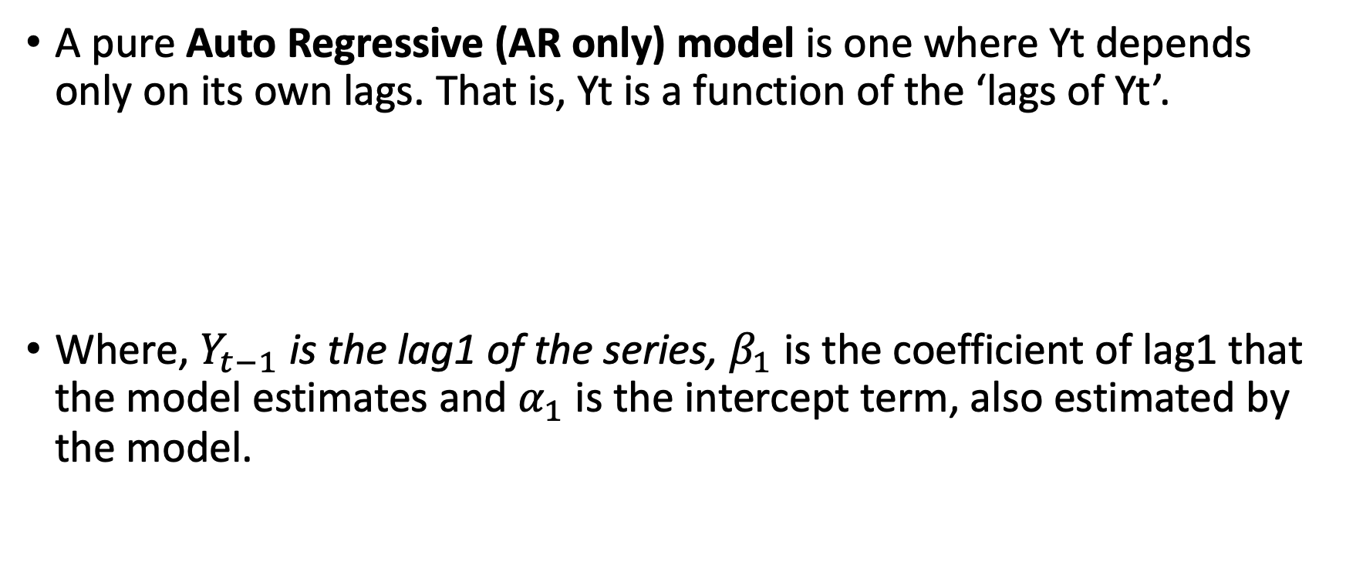
How does ARIMA/SARIMA model work?
A pure Auto Regressive (AR only) model is one where Yt depends only on its own lags. That is, Yt is a function of the ‘lags of Yt’.
Where, $Y_{t−1}$is the lag1 of the series, $β_{1}$ is the coefficient of lag1 that the model estimates and $α_{1}$ is the intercept term, also estimated by the model.

Slide 11
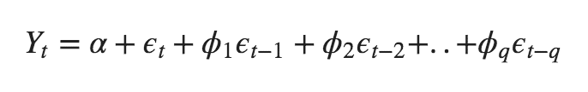
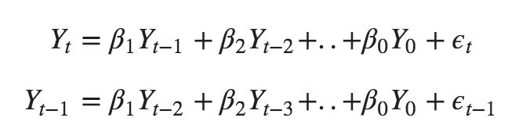
How does ARIMA/SARIMA model work?
Likewise a pure Moving Average (MA only) model is one where Yt depends only on the lagged forecast errors.
Where the error terms are the errors of the autoregressive models of the respective lags. The errors Et and E(t-1) are the errors from the following equations :

Slide 12
How does ARIMA/SARIMA model work?
An ARIMA model is one where the time series was differenced at least once to make it stationary and you combine the AR and the MA terms. So the equation becomes:
ARIMA model in words:
Predicted Yt = Constant + Linear combination Lags of Y (upto p lags) + Linear Combination of Lagged forecast errors (upto q lags)
The objective, therefore, is to identify the values of p, d and q.

Slide 13
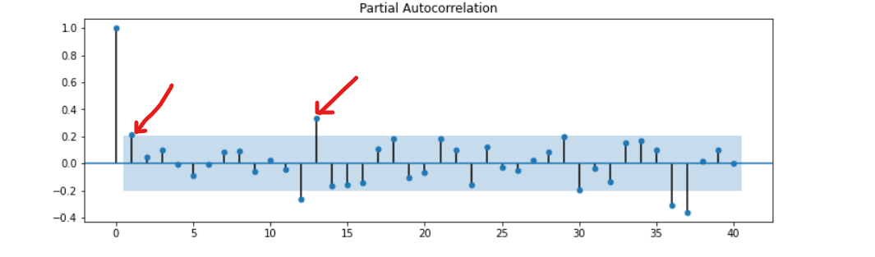
How does ARIMA/SARIMA model work?
p: It represents the order of the Auto Regression (AR) component. It represents the number of lag observations found in the ARIMA model. A lag is the time gap between two data points/observations in the time series. We get the best value of p using a Partial Autocorrelation Function (PACF) plot.
From the PACF plot, we can observe that lags 1 and 13 stand out. The red arrow shows the lag points.
These points are above (cuts off) the significance line (the blue shaded line). We select lag number one as the best value of p. It is the first lag that is above the blue line. Therefore, p=1.

Slide 14
How does ARIMA/SARIMA model work?
d: It is the total differencing steps performed to make the time series stationary. If the time-series data is already stationary, there is no need for differencing.

Slide 15
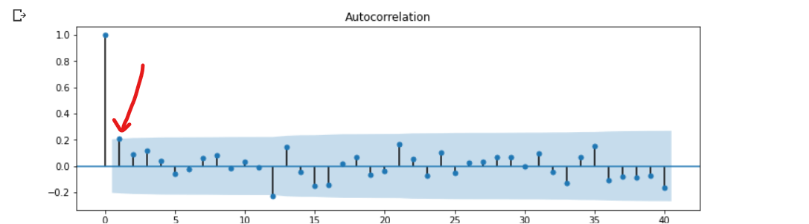
How does ARIMA/SARIMA model work?
q: It represents the order of the Moving Average (MA) component. It shows the forecast errors that the final ARIMA Model should have. We get the best value of q using an AutoCorrelation Function (ACF) plot.
From the ACF plot, lag number one stands out. The red arrow shows the lag point. It is slightly above (cuts off) the significance line (the blue line). We will select this lag as the best value of q. Therefore, q=1.

Slide 16
How does ARIMA/SARIMA model work?
Now that you’ve determined the values of p, d and q, you have everything needed to fit the ARIMA model. Let’s use the ARIMA() implementation in statsmodels package.

Slide 17
How does ARIMA/SARIMA model work?
SARIMA will handle and model time series data with repeating cycles or seasonality. From the earlier ADF test, the dataset has seasonality. We initialize the SARIMA model as SARIMA (p,d,q)(P, D, Q, s). We already have the p, d, and q values.
We can get the P, D, Q in the same way. Thus, p=P, q=Q, and d=D. s=12 since there are 12 months in a year.

Slide 18
Vector AutoRegression(VAR)?
VAR models are different from univariate autoregressive models because they allow analysis and make predictions on multivariate time series data.
Vector autoregression (VAR) is a statistical model for multivariate time series analysis, especially in a time series where the variables have a relationship that affects each other to time.
VAR models are different from univariate autoregressive models because they allow analysis and make predictions on multivariate time series data.
VAR models are often used in economics and weather forecasting.

Slide 19
Vector AutoRegression(VAR)?
Basic requirements to use the VAR model are:
Time series with at least two variables.
Relationship between variables.
It is considered an autoregressive model because the predictions made by the model are dependent on the past values, which means that each observation is modelled as the function of its lagged value.

Slide 20
Vector AutoRegression(VAR)?
The basic difference between the ARIMA family and VAR models is that all the ARIMA models are used for univariate time series, where the VAR models work with multivariate time series. In addition, ARIMA models are unidirectional models, which means that the dependent variables are influenced by their past or lag values itself, where VAR is a bi-directional model, which means a dependent variable is affected by its past value or by another variable’s value or influenced by both of the things.

Slide 21
Vector AutoRegression(VAR)?
A typical autoregression model(AR(p)) for univariate time series can be represented by
Where
y_{t−i} indicates the variable value at periods earlier.
A_{i} is a time-invariant (k × k)-matrix.
e_{t} is an error term.
c is an intercept of the model.
Here the order p means, up to p-lags of y is used

Slide 22
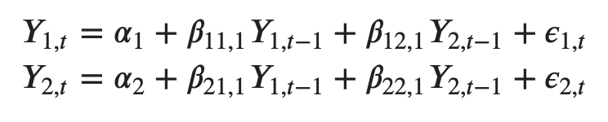
Vector AutoRegression(VAR)?
As we know, the VAR model deals with multivariate time series, which means there will be two or more variables affecting each other. Therefore, the VAR model equation increases with the number of variables in the time series
Let’s suppose there are two time-series variables, y1 and y2, so to calculate y1(t), the VAR model will use the lags of both time-series variables.
For example, the equation for the VAR(1) model with two time-series variables (y1 and y2) will look like this:

Slide 23
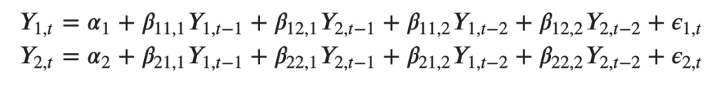
Vector AutoRegression(VAR)?
And the VAR(2) with y1 and y2 time series variables, the equation of the model will look like :

Slide 24


